Slide 1
Team Details
Team Name: Hackstreet Devs
Members: Abdul Razique, Shahid Sayyed, Ayush Raj Tiwary
Project Name: Triply – Smart Group Trip Planner
GitHub Repository: https://github.com/abdulrazique87/Triply-smart-planning-for-trips.

Slide 2
Problem Statement
Problem: Trip planning with friends or family is often stressful and disorganized due to information being scattered across different apps (chat, calendar, budget, maps, etc.) and poor communication between group members.
⚠️ Impact:
Planning becomes a time-consuming chore, often leading to confusion, missed bookings, and less enjoyable trips. Coordinating preferences, budgets, and schedules is a headache, especially for larger groups.
💡 Proposed Solution
Triply is an AI-assisted group trip planner that brings everything into one platform — combining:
✅ Scheduling
💰 Budget management
🧭 Activity suggestions
🗺️ Integrated maps
💬 Group communication

Slide 3
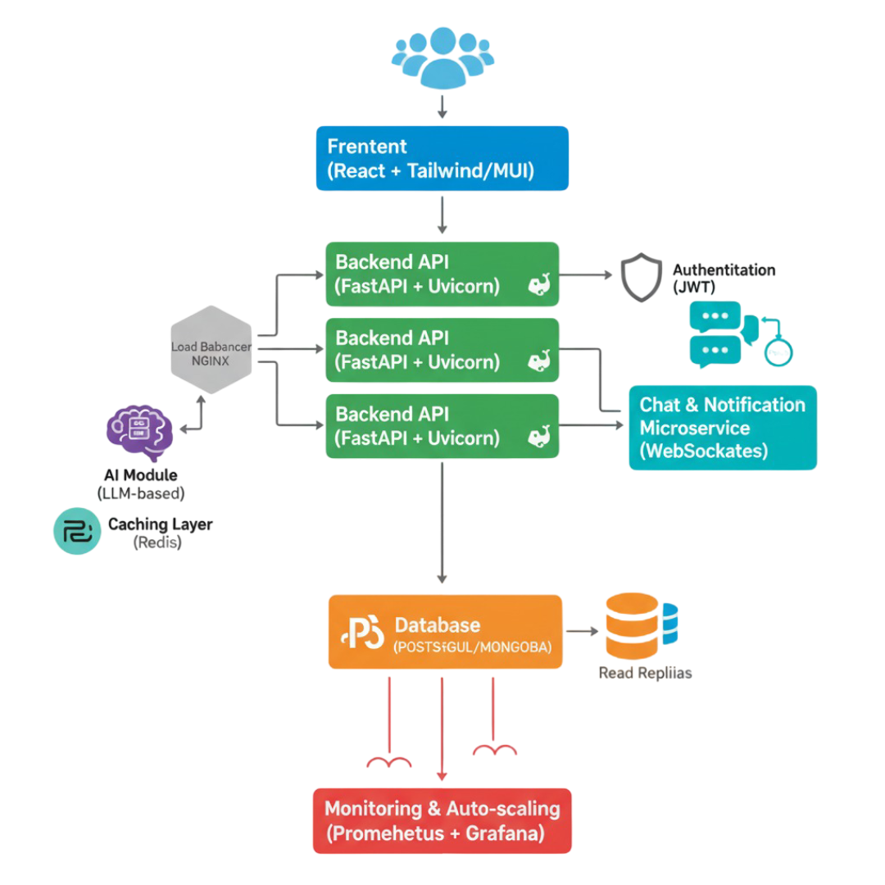
System Architecture

Slide 4
Tech Stack & Feasibility
💻 Tech Stack
Category | Technology
Frontend | React, Tailwind CSS / MUI
Backend | FastAPI, Docker (containerized deployment)
Database | PostgreSQL / MongoDB
AI Module | LLM (Large Language Model) for:
 | - Activity Suggestions
 | - Trip Summarization
Maps & Location | Google Maps API / Mapbox
Authentication | JWT (JSON Web Tokens)
Real-time Features | WebSockets, Redis Pub/Sub or Kafka
Deployment & Infra | Cloud hosting with Auto-scaling (AWS/GCP)
📈 Feasibility
MVP can be built within 7 days
Core features (trip planner, budget, chat, activity suggestions) are technically feasible using existing tools
Uses familiar, widely-supported open-source technologies

Slide 5
Future Scope
🚀 Planned Features & Improvements
Use a horizontal or vertical timeline/roadmap with icons or small visuals.
Each point on the roadmap:
Multi-city & multi-day routing
Integration with hotel/flight bookings
Live collaborative itinerary editing
Gamification – rewards & badges
Mobile App + Push Notifications
🎨Design Notes:
Clean, modern layout with light background
Blue & green accent colors
Bold headings, readable fonts
Minimal text, icon-based visuals
Consistent styling across all slides

